Slide 1
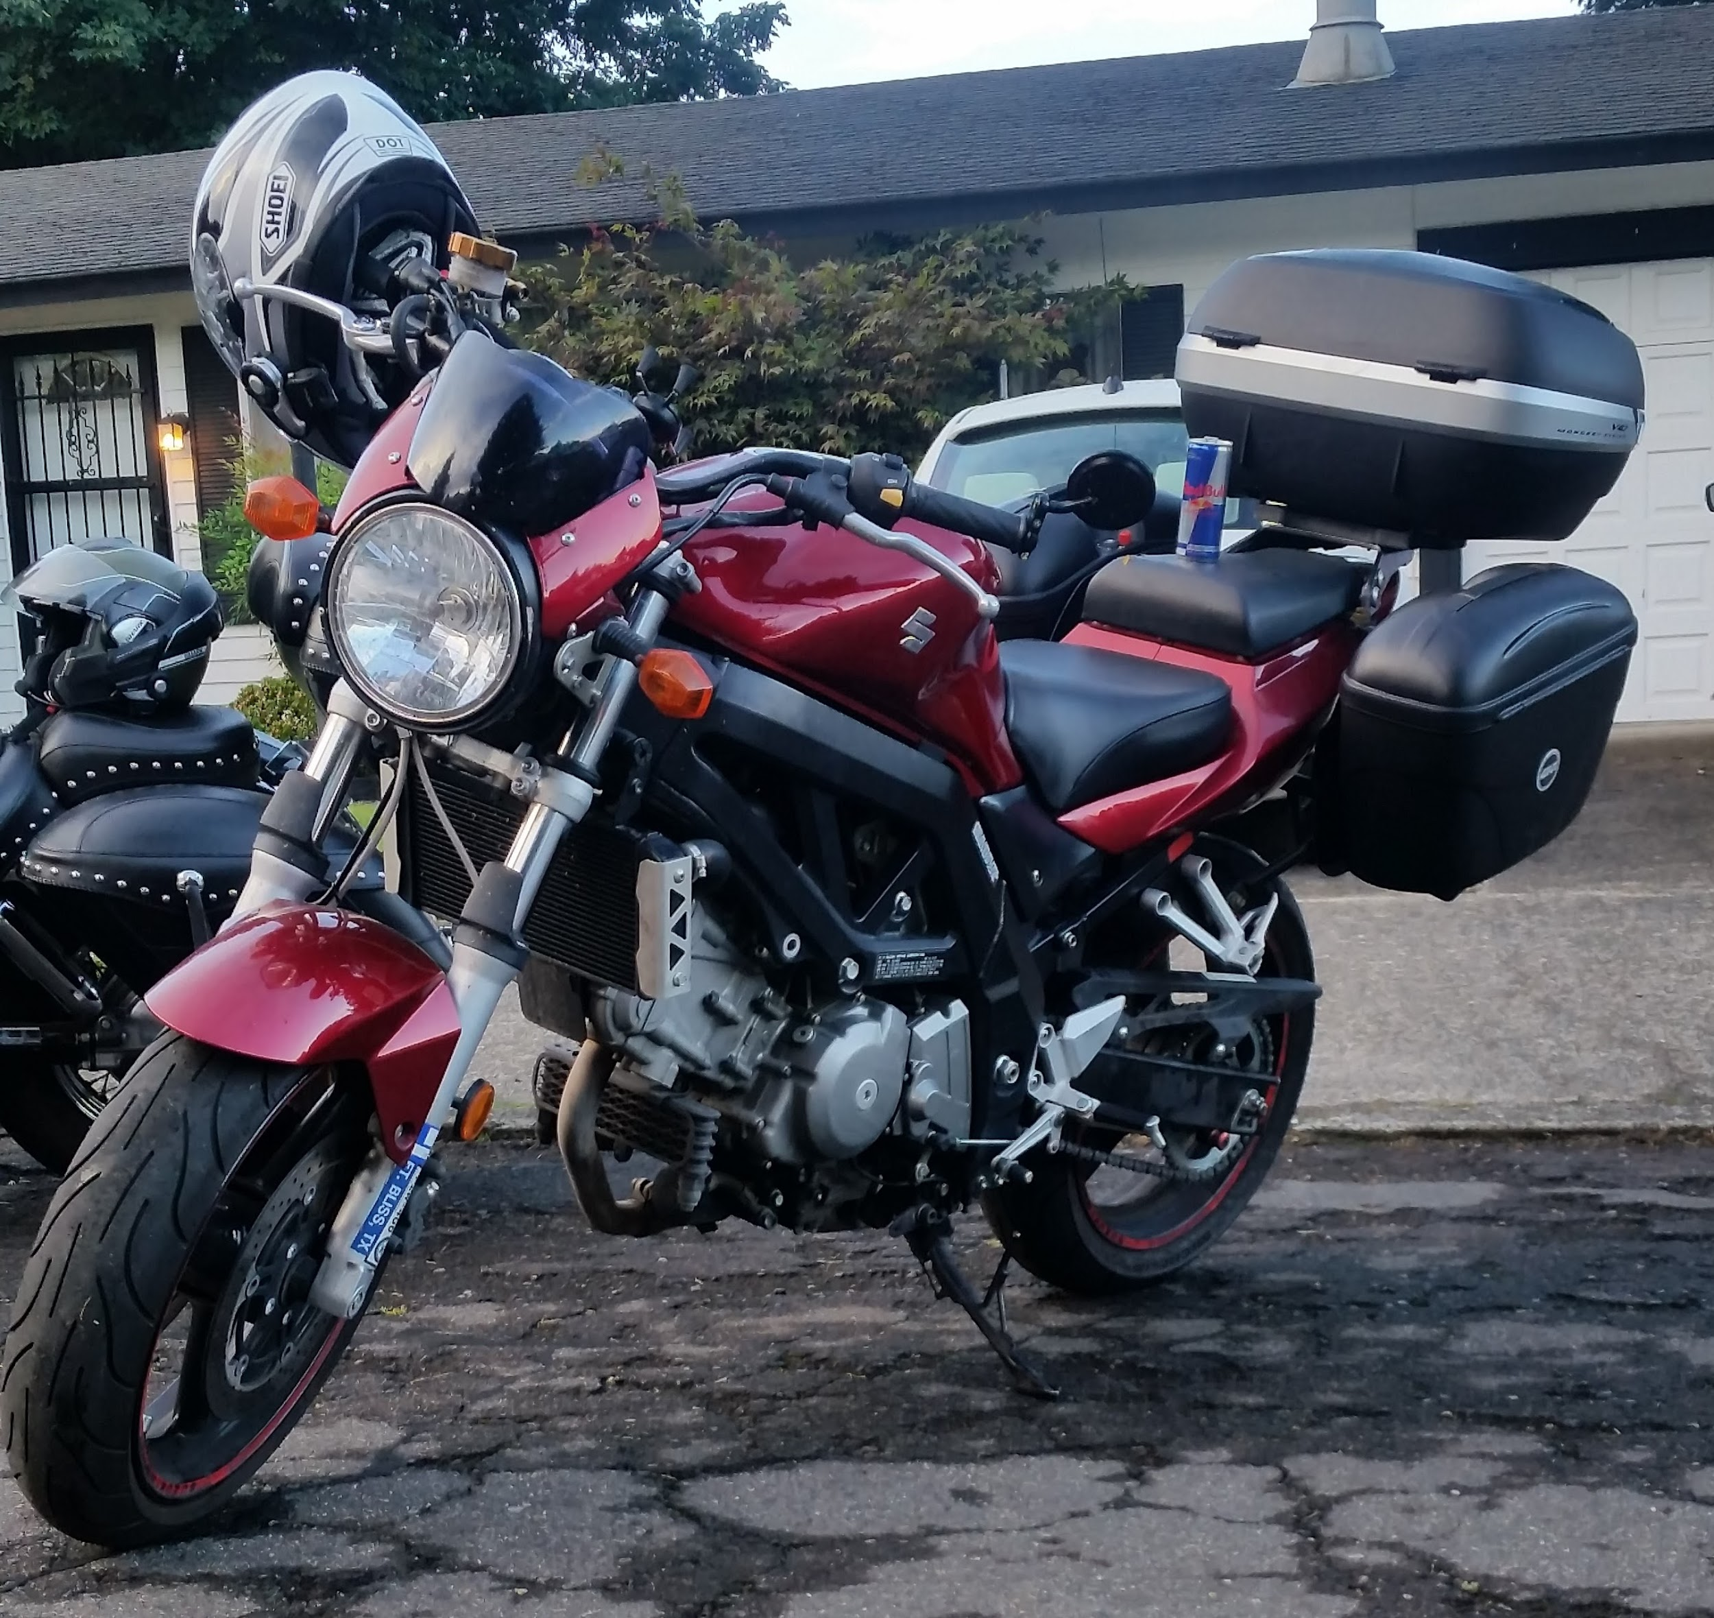
The Motorcycle Protection
Project

Slide 2
Overview
Main Goals
Notification if motorcycle is tipped over.
Notification if motorcycle is moved.
User can get current GPS Cords by use of an IoT button.
Stretch Goals
Rain notification using barometric pressure.
Horn Activation on IoT long press.

Slide 3
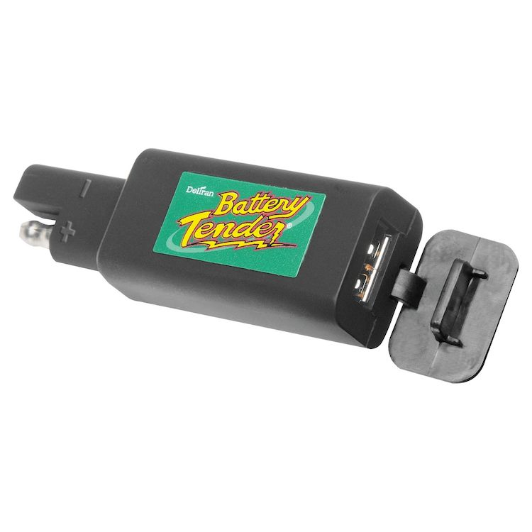
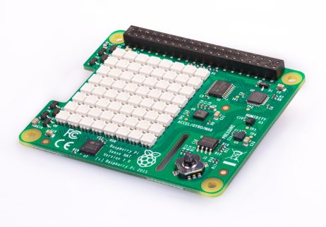
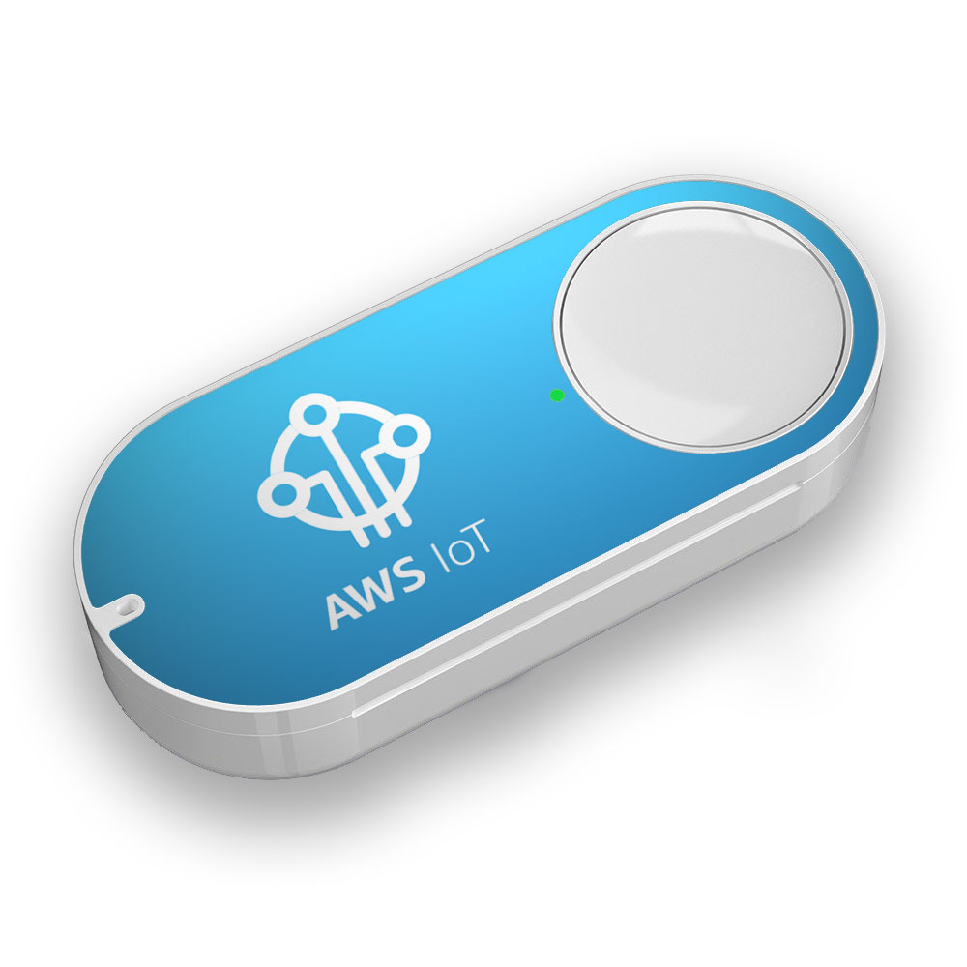
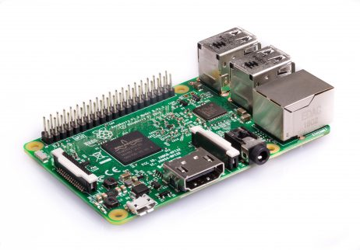
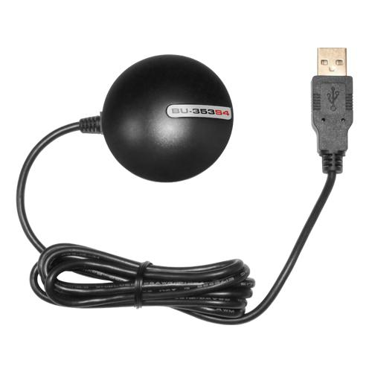
SENSEHAT
Amazon Lambda
For Power
gpsd
Python

Slide 4

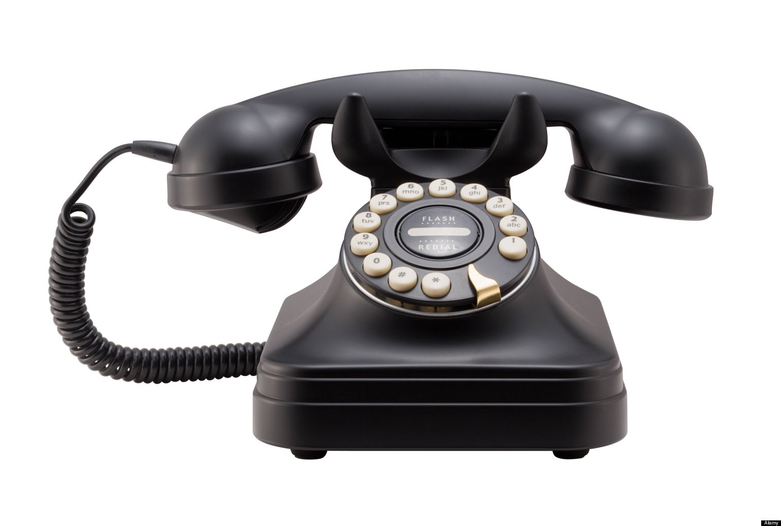

Slide 5
Interface.
User inputs their email address before installation on motorcycle.
Activated during RPi start up, User receives confirmation email.
User receives email when RPi sense abnormal measurements.
User receives GPS cords, on IoT button press.

Slide 6
from sense_hat import SenseHat
import time
sense = SenseHat()
import sys
while True:
acceleration = sense.get_accelerometer_raw()
x = acceleration['x']
y = acceleration['y']
z = acceleration['z']
if x > y and x > z:
sense.show_letter("X")
if z > y and z > y:
sense.show_letter("Z")
else:
sense.show_letter("Y")
x = round(x, 2)
y = round(y, 2)
z = round(z, 2)
time.sleep(.75)
print("x={0}, y={1}, z = {2}".format(x, y, z))
DEMO
Notes:
from sense_hat import SenseHat
import time
sense = SenseHat()
import sys
while True:
acceleration = sense.get_accelerometer_raw()
x = acceleration['x']
y = acceleration['y']
z = acceleration['z']
if x > y and x > z:
sense.show_letter("X")
if z > y and z > y:
sense.show_letter("Z")
else:
sense.show_letter("Y")
x = round(x, 2)
y = round(y, 2)
z = round(z, 2)
time.sleep(.75)
print("x={0}, y={1}, z = {2}".format(x, y, z))

Slide 7
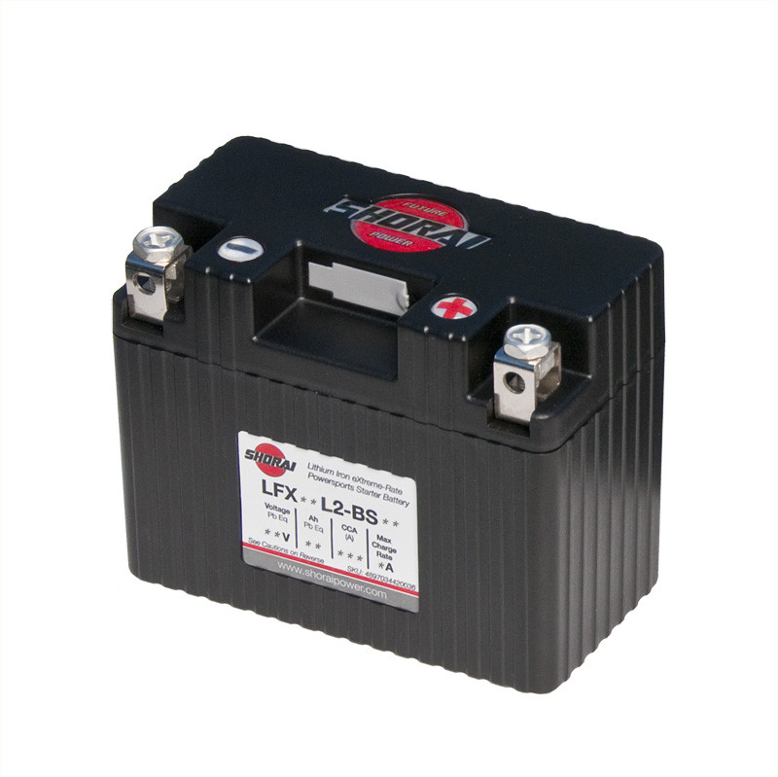

Security Concerns
Secure the RPi.
Hide it on the motorcycle, protect the power source.

Slide 8
Milestones
Nov 14 -> Parts bought and proof of concept complete
Nov 21 -> Email notification of abnormal acceleration readings, Construction Doc
Nov 28 -> Device sends gps coordinates upon abnormal acceleration readings
Dec 4 -> Device sends gps coordinates upon IOT Button click
Dec 12 -> Project and all documentation complete

Slide 9
Q&A

